Slide 1



Computational Modelling of The Human Wrist Joint
Manvitha Kalicheti
Under the supervision of Prof. Masahiro Todoh,
Laboratory of Biomechanical Design,
Hokkaido University.

Slide 2
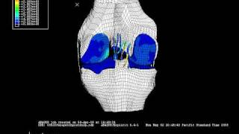
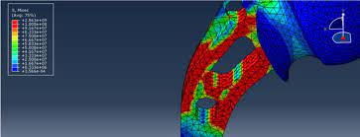
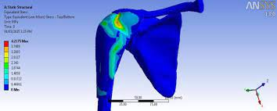
Aim and Motivation
FEM models of the hip, knee and shoulder joints are common. The wrist and ankle are too complex and not many satisfactory models exist.
Using a paper titled “Finite element model creation and stability considerations of complex biological articulation: The human wrist joint” as a reference, we attempted to model the human wrist joint in a more realistic way.
Gíslason MK, Stansfield B, Nash DH. Finite element model creation and stability considerations of complex biological articulation: The human wrist joint. Med Eng Phys. 2010 Jun;32(5):523-31. doi: 10.1016/j.medengphy.2010.02.015. PMID: 20303315.

Slide 3
Parts modelled
The 5 metacarpals (the palm)
The 8 carpal bones (the wrist)
Distal Radius and Ulna (the forearm)
Cartilages
Ligaments
Source of data: MRI data sets

Slide 4
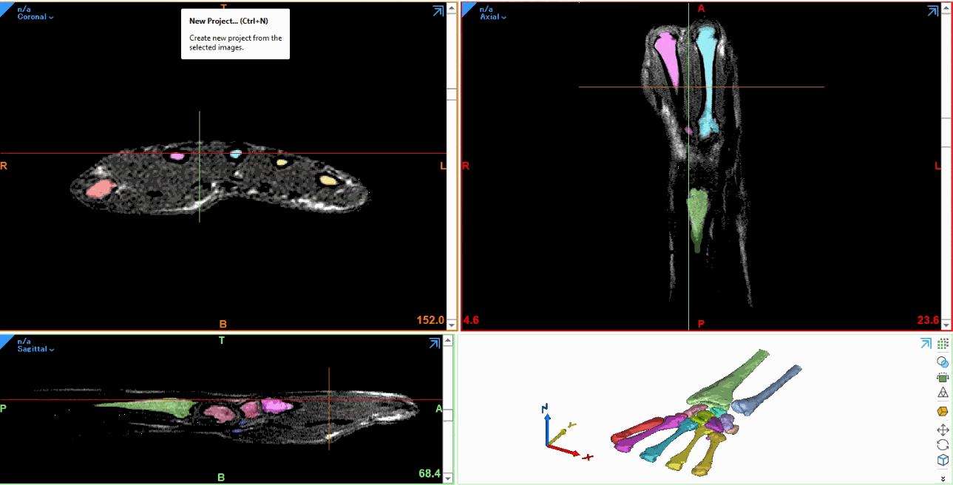
Modelling of bones
Tools: Materialise Mimics- medical 3D image-based engineering software

Slide 5
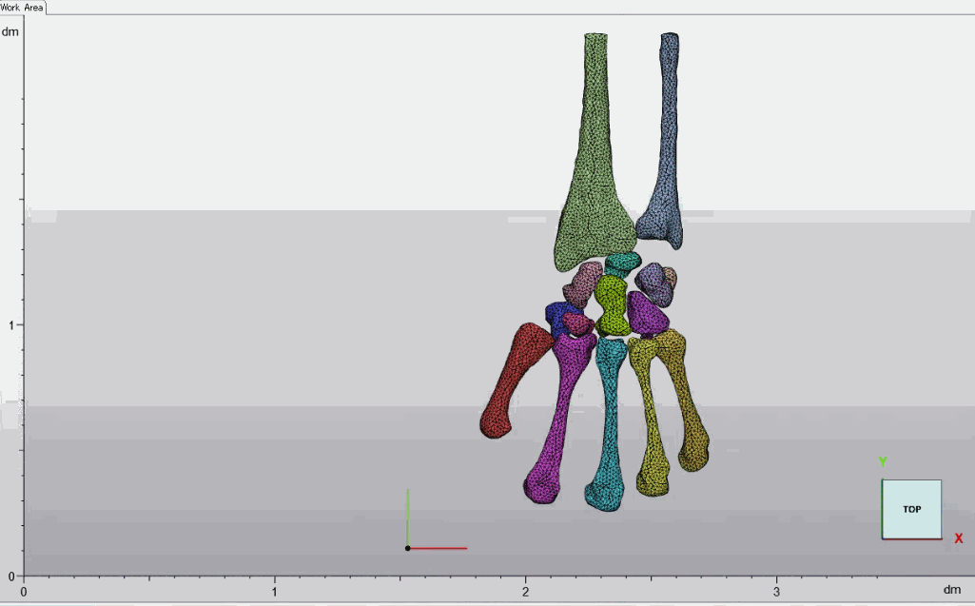
Meshing
Tools: Materialise 3-matic- a 3D modeling software program that enables design optimization and modification on mesh level, using CAD designs, scanned data and topology optimized models as a starting point.

Slide 6
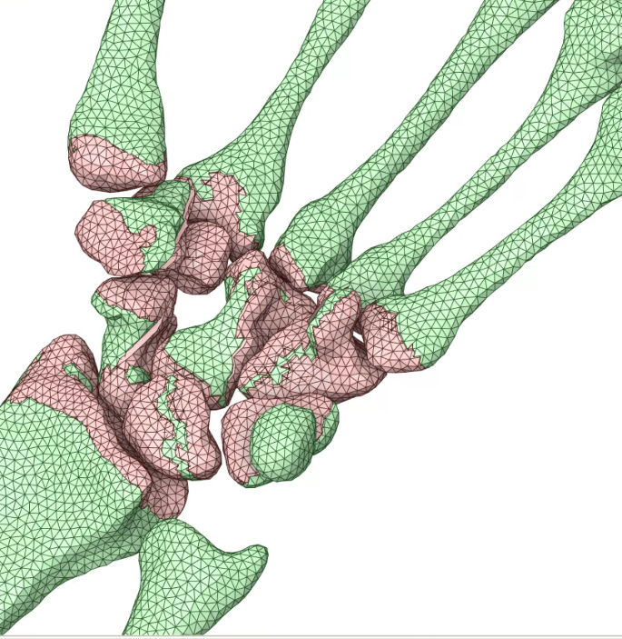
Modelling of Cartilage
Tools: Ansys Spaceclaim- 3D CAD modelling software
Bones were copied, and the copied bones were offset appropriately and subtracted from the original bones.

Slide 7
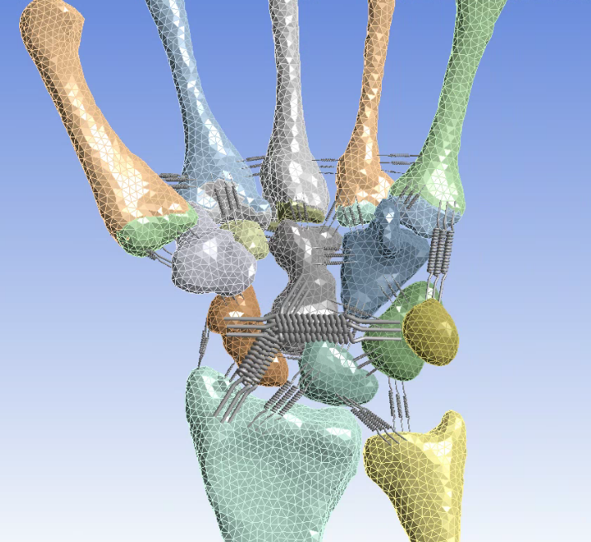
Modelling of Ligaments
Tools: Ansys Mechanical
The ligaments are modelled as nonlinear springs in parallel.

Slide 8
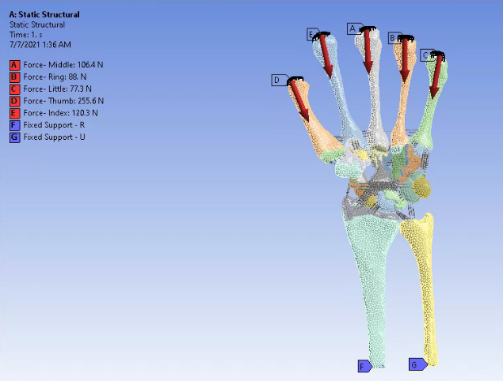
Loads and BCs
The action of gripping is considered.
Proximal ends of the radius and ulna - fixed.
Compressive loads on the metacarpals - determined from biomechanical experiments using force transducers.

Slide 9
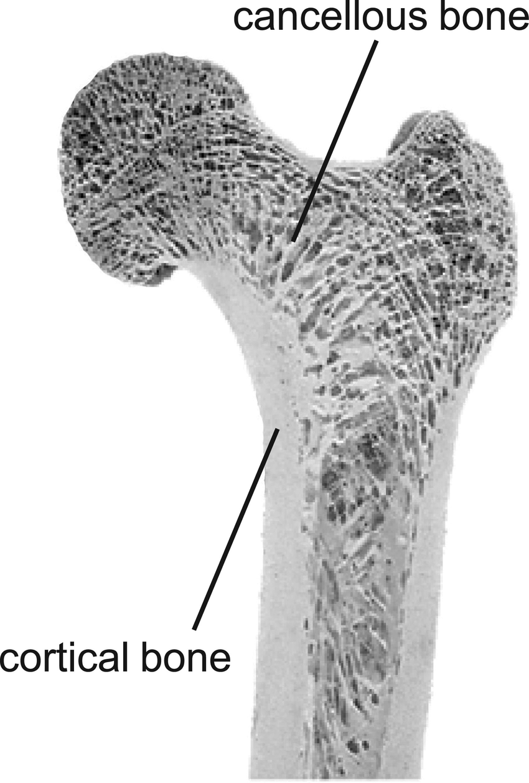
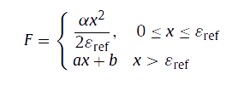
Materials
The cartilage was assigned a hyperelastic material modelled using the Mooney-Rivlin 2 parameter model.
The bones can either be split into cortical and cancellous parts, or be modelled as rigid bodies depending on the focus of the simulation.
The ligaments have to be modelled as nonlinear springs with the relationship between the ligament force (F) and the strain (x) as follows (where ϵ_{F} is 15% of the maximum strain):

Slide 10
Further work
The simulation will be ready to run after:
The material of the bones and the ligaments are set up
The contacts between articulating surfaces are defined
Once we have a working model, there are several wide applications possible:
Dynamic model - prosthetic design
Static model - study of progression of ailments
Further work can be done to include muscles and tendons.

Slide 11
Acknowledgements
I would like to thank Prof. Todoh, my supervisor, and Prahasith-san, my tutor, for making my stint at the Lab of Biomechanical Design smooth and for the helpful guidance.
I am immensely grateful to the STSI program and staff, Hokkaido University, Dr. Ashok Kumar Pandey and IIT Hyderabad for giving me the opportunity to do something fruitful and exciting with my summer despite the pandemic.

Slide 12
Arigato Gozaimashita!

